Slide 2
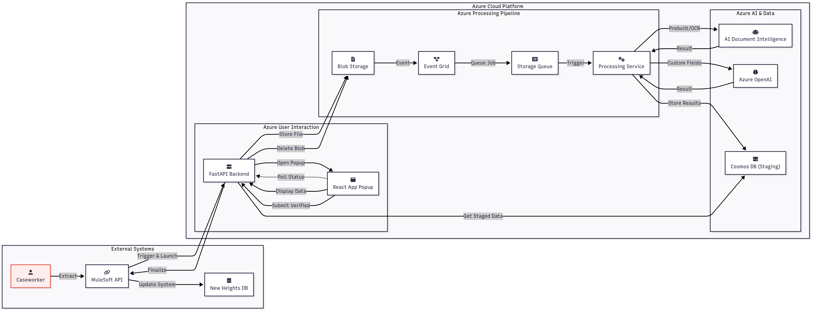
DOC EXTRACTION/ AZURE ARCHITECTURE FLOW

Slide 3
DOC EXTRACTION – TOOLS/Services
1 | Azure Container Apps | Hosts our Python applications (the main FastAPI backend and the background Processing Service) in a scalable, serverless container environment. | Azure
2 | Azure Static Web Apps | Hosts the front-end React application (the popup UI), optimized for delivering static content globally with high performance and low cost. | Azure
3 | AI Document Intelligence | A suite of AI models used to perform the initial quality checks, classify the document type, run OCR, and extract all standard fields with the pre-built paystub model. | Azure
4 | Azure OpenAI Service | Provides the advanced LLM (GPT-4) needed to reason over the OCR text and extract the specific custom fields that pre-built models might miss. | Azure
5 | Azure Cosmos DB | A high-performance NoSQL database used as our staging and job-tracking database. It stores the status of each processing job and the final extracted JSON data. | Azure
6 | Azure Blob Storage | Provides secure, temporary storage for the incoming pay stub documents during the processing phase before they are deleted. | Azure
7 | Event Grid & Storage Queue | This pair of services creates a resilient, asynchronous processing pipeline. Event Grid detects new files, and Storage Queue creates a to-do list to reliably handle high volumes. | Azure
8 | Azure Key Vault | Securely stores and manages all application secrets, such as API keys and database connection strings, ensuring they are never hard-coded in our application. | Azure
9 | Azure Monitor (Includes Azure Policy) | The central monitoring service that collects all logs, performance metrics, and errors from every other service, providing observability and alerting for the entire system. | Azure
10 | React JS | A JavaScript library used to build the rich, interactive user interface for the popup window that displays progress and the final review screen. | Open Source
11 | Bitbucket | A Git-based source code repository hosting service. It is used to manage the project's codebase, track changes, and collaborate on development. | Atlassian

Slide 4
Azure Services Required
The estimate below is based on the production workload of 30,000 documents per month and 100+ daily active caseworkers.
Grouping | Azure Services | Estimated Monthly Cost
Generative AI | Azure AI Document Intelligence | $435
 | Azure OpenAI Service | $90
Infrastructure | Azure Container Apps (Backend + Processor) | $40 - $75
 | Azure Static Web Apps (Frontend) | $9
Storage | Azure Cosmos DB (Staging Database) | $60 - $120
 | Azure Blob Storage (Temporary File Storage) | $5 - $10
Monitoring | Azure Monitor (Logging & Metrics)-Includes Azure Policy | $15 - $25
Security | Azure Key Vault (Secrets Management) | $5
Approx. Monthly Cost |  | $659 - $769 USD
Approx. Yearly Cost |  | $7,908 - $9,228 USD

